Slide 1
CHAPTER Imperfect
15 Competition

Slide 2
Short-Run Decisions: Pricing And Output
Oligopoly
  A market with relatively few firms but more than one
  Possibility of strategic interaction among firms
  Difficult to predict exactly the possible outcomes for price and output

Slide 3
Short-Run Decisions: Pricing & Output
Bertrand model
  Two identical firms choosing prices simultaneously for identical products
    Situation similar to perfect competition
Cartel model
  Firms act as a group - Monopoly outcome
Cournot model
  Firms set quantities rather than prices
    Between the Bertrand and the cartel models

Slide 4
15.1 Pricing and Output under Imperfect
Competition
Market equilibrium under imperfect competition can occur at many points on the demand curve. In the figure, which assumes that marginal costs are constant over all output ranges, the equilibrium of the Bertrand game occurs at point C, also corresponding to the perfectly competitive outcome. The perfect cartel outcome occurs at point M, also corresponding to the monopoly outcome. Many solutions may occur between points M and C, depending on the specific assumptions made about how firms compete. For example, the equilibrium of the Cournot game might occur at a point such as A. The deadweight loss given by the shaded triangle increases as one moves from point C to M.
Price
M
P_{M}
1
A
P_{A}
2
3
C
P_{C}
MC=AC
D
MR
Q_{M}
Q_{A}
Q_{C}
Quantity

Slide 5
Bertrand Model
Two identical firms
  Producing identical products at a constant
  MC = AC = c
  Choose prices p₁ and p₂ simultaneously
    Single period of competition
  Sales
    All sales go to the firm with the lowest price
    Sales are split evenly if p₁ = p₂
  Market demand D(p)

Slide 6
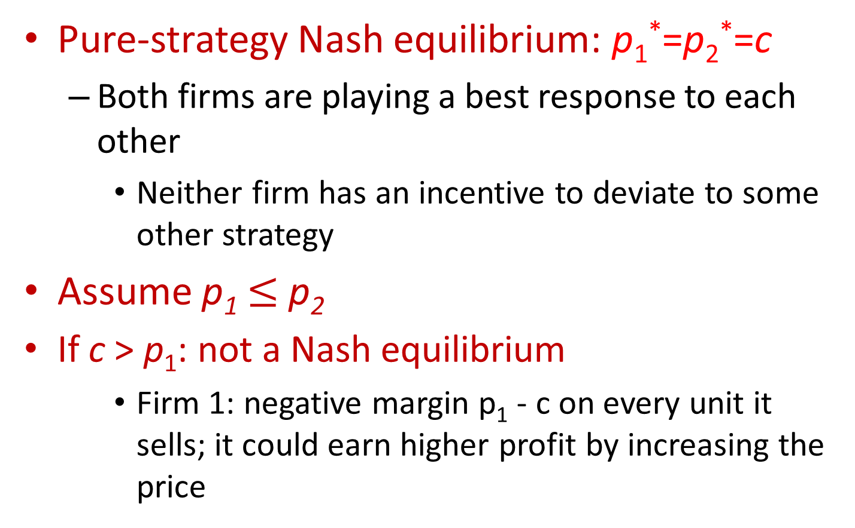
Nash Equilibrium of the Bertrand Model
Pure-strategy Nash equilibrium: p₁*=p₂*=c
  Both firms are playing a best response to each other
    Neither firm has an incentive to deviate to some other strategy
Assume p₁ $≤$ p₂
If c > p₁: not a Nash equilibrium
    Firm 1: negative margin p₁ - c on every unit it sells; it could earn higher profit by increasing the price

Slide 7
Nash Equilibrium of the Bertrand Model
If c < p₁ : not a Nash equilibrium
  Firm 2 could capture all the market demand by undercutting firm 1’s price by a tiny amount
If c = p₁ < p₂: not a Nash equilibrium
  Firm 1 earns zero profit here but could earn positive profit by deviating to a price slightly above c but still below p₂

Slide 8
Nash Equilibrium of the Bertrand Model
For any number of firms n ≥ 2
  The same result
  Nash equilibrium of the n-firm Bertrand game is p₁* = p₂* = … = p_{n}*= c

Slide 9
Bertrand Paradox
The Bertrand paradox
  The Nash equilibrium of the Bertrand model is the same as the perfectly competitive outcome
    Price is set to marginal cost
    Firms earn zero profit

Slide 10
Cournot Model
Firms
  Each firm chooses its output q_{i} of an identical product simultaneously
Total industry output: Q = q₁ + q₂ +…+ q_{n}
  Determines the market price P(Q)
P(Q)
  Is the inverse demand curve corresponding to the market demand curve Q = D(P)
    Both downward sloping: P’(Q) < 0

Slide 11
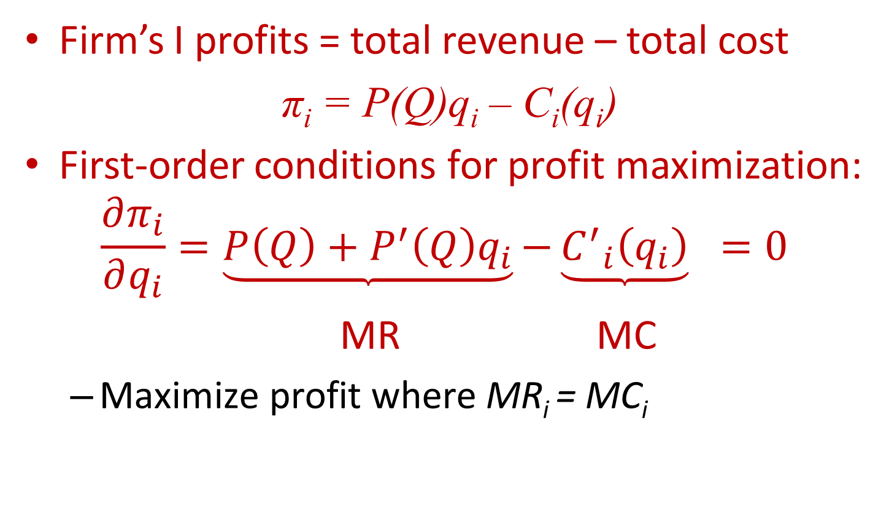
Cournot Model
Firm’s I profits = total revenue – total cost
π_{i} = P(Q)q_{i} – C_{i}(q_{i})
First-order conditions for profit maximization:
$$\frac{∂π_{i}}{∂q_{i}}=\underbrace{P\left(Q\right)+P^{′}\left(Q\right)q_{i}}{−\underbrace{{C^{′}}_{i}\left(q_{i}\right)}}_{}=0$$
MR MC
  Maximize profit where MR_{i} = MC_{i}

Slide 12
Cournot Model
Price
  Exceeds marginal cost by P’(Q)q_{i}
Industry profits
  Lower than in the cartel model
Social welfare
  Greater in the Cournot model than in the cartel situation

Slide 13
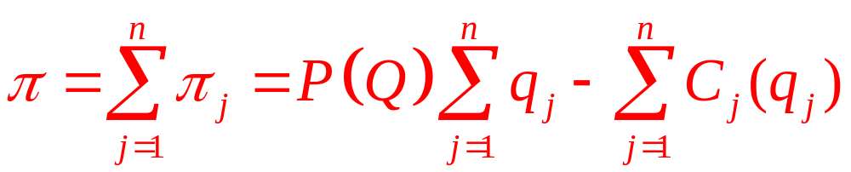
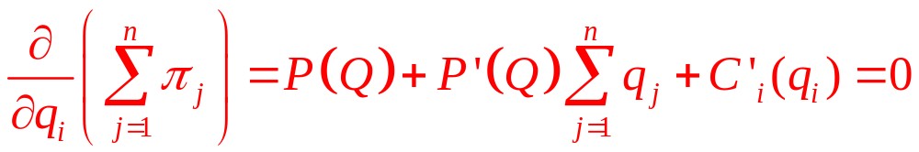
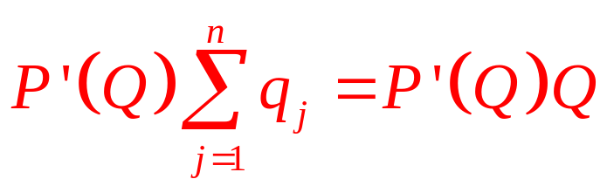
Cartel Model
Each firm chooses q_{i} for each firm
  So as to maximize total industry profits
  First-order conditions for a maximum:
  Same result as Cournot, except that price exceeds marginal cost by

Slide 14
15.1 Natural-Spring Duopoly
Two owners of natural springs
  Firm’s cost of pumping and bottling q_{i} liters is C_{i}(q_{i}) = cq_{i}
  Each firm has to decide how much water to supply to the market
The inverse demand function, P(Q) = a – Q
  a is demand intercept and Q = q₁ + q₂
Bertrand model
  The two firms set price equal to marginal cost
    Market price = P* = c; total output = Q* = a – c
    π*_{i} = 0; total profit for all firms = Π* = 0

Slide 15
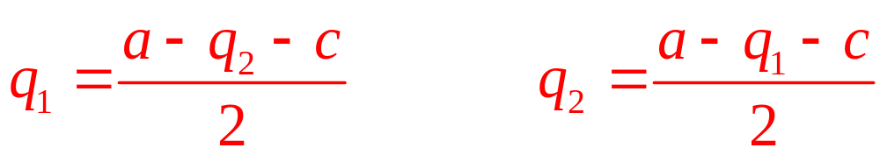
15.1 Natural-Spring Duopoly
Cournot model
  π₁ = P(Q)q₁ – cq₁ = (a – q₁ – q₂ – c)q₁
  π₂ = P(Q)q₂ – cq₂ = (a – q₁ – q₂ – c)q₂
The Nash equilibrium
  q₁* = q₂* = (a – c)/3
  total output = Q* = (2/3)(a – c)
  P* = (a + 2c)/3; π₁* = π₂* = (1/9)(a – c)²
  total profit for all firms = Π* = π₁* + π₂* =(2/9)(a – c)²

Slide 16
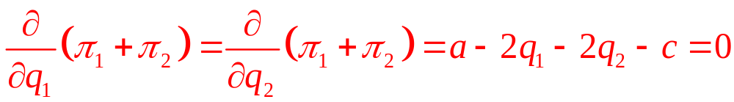
15.1 Natural-Spring Duopoly
Perfect cartel
  Objective function - involves joint profits
π₁ + π₂ = (a – q₁ – q₂ – c)q₁ + (a – q₁ – q₂ – c)q₂
  First-order conditions for a maximum:
  total output = q₁* + q₂* = Q* = (1/2)(a – c)
  P* = (1/2)(a + c)
  total cartel profit = Π* = (1/4)(a – c)²

Slide 17
15.2 Cournot Best-Response Diagrams
Solve for the Nash equilibrium using graphical methods
  Graph the intercepts of the best-response functions
  Intersection between the best responses is the Nash equilibrium
An isoprofit curve for firm 1
  Is the locus of quantity pairs providing it with the same profit level

Slide 18
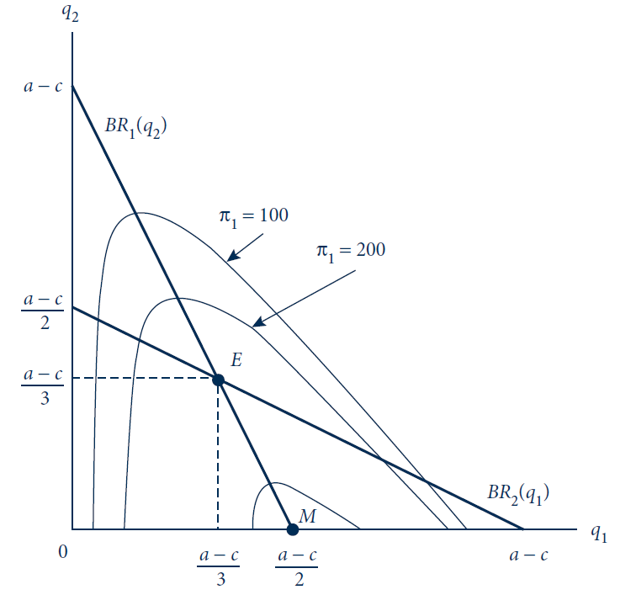
15.2 Best-Response Diagram for Cournot Duopoly
Firms’ best responses are drawn as thick lines; their intersection (E) is the Nash equilibrium of the Cournot game. Isoprofit curves for firm 1 increase until point M is reached, which is the monopoly outcome for firm 1.

Slide 19
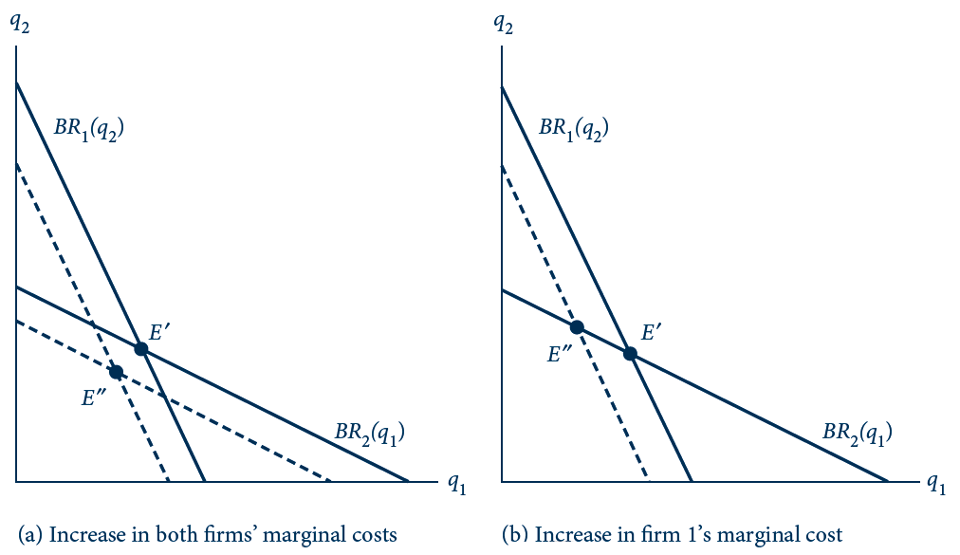
15.3 Shifting Cournot Best Responses
Firms’ initial best responses are drawn as solid lines, resulting in a Nash equilibrium at point E’. Panel (a) depicts an increase in both firms’ marginal costs, shifting their best responses—now given by the dashed lines—inward. The new intersection point, and thus the new equilibrium, is point E’’. Panel (b) depicts an increase in just firm 1’s marginal cost.

Slide 20
Varying the Number of Cournot Firms
The Cournot model
  Can represent the whole range of outcomes by varying the number of firms
  n = ∞ ⇒ perfect competition
  n = 1 ⇒ perfect cartel / monopoly
n identical firms
  Same cost function C(q_{i})
  In equilibrium, each produces q_{i} = Q/n

Slide 21
Varying the Number of Cournot Firms
Difference between price and marginal cost: P’(Q)Q/n
  The wedge term disappears as n grows large; firms become infinitesimally small – price takers
    Price approaches marginal cost
    Market outcome approaches the perfectly competitive one
  As n decreases to 1: the Cournot outcome approaches that of a perfect cartel

Slide 22
15.3 Natural-Spring Oligopoly
A variable number n of firms
  The profit of firm i:
π_{i} = P(Q)q_{i} – cq_{i} = (a – q_{i} – Q_{-i} - c)q_{i}
  Total output Q = q_{i} + Q_{-i}
      Where Q_{-i} = Q - q_{i} output of all firms except for i
First-order conditions
  ∂π_{i} /∂q_{i} = a – 2q_{i} – Q_{-i} – c = 0
Symmetry:
  Q_{-i}* = Q* - q_{i}* = n q_{i}* - q_{i}* = (n-1) q_{i}*

Slide 23
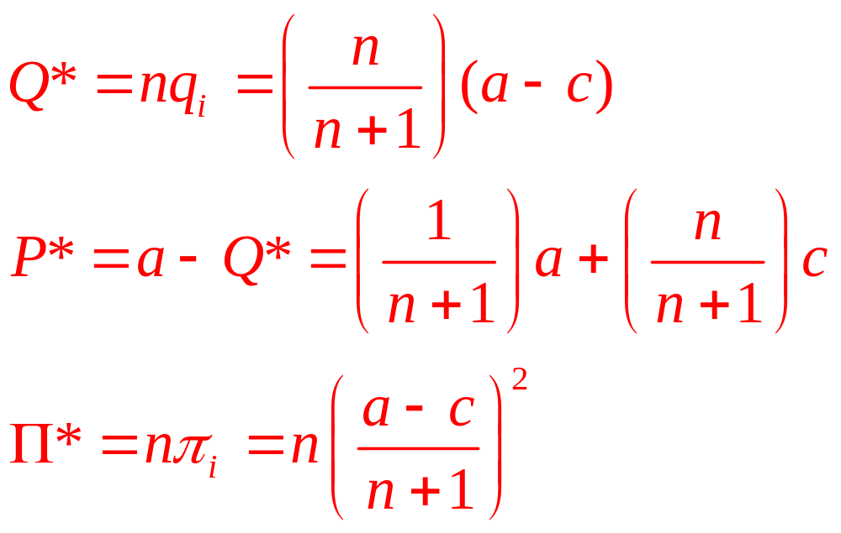
15.3 Natural-Spring Oligopoly
  q_{i}* = (a-c)/(n+1)

Slide 24
Prices or Quantities?
Bertrand model - price competition
  Discontinuous jump from monopoly to perfect competition if just two firms enter
  Additional entry beyond two has no additional effect on the market outcome
Cournot model - quantity competition
  Industry grows more competitive as the number n of firms entering the market increases

Slide 25
Capacity Constraints
For the Bertrand model to generate the Bertrand paradox
  Firms must have unlimited capacity
  More realistically, firms may not have an unlimited ability to meet all demand

Slide 26
Capacity Constraints
Two-stage game
  Firms build capacity in the first stage
  Firms choose prices p₁ and p₂ in the second stage
  Sales of firms cannot exceed the capacity chosen in the first stage
  If the cost of building capacity is sufficiently high
    Equilibrium - the same as the Nash equilibrium of the Cournot model

Slide 27
Product Differentiation
To avoid the Bertrand paradox
  Assume that firms produce differentiated products
Market
  A group of closely related products
    That are more substitutable among each other
      As measured by cross-price elasticities
    Than with goods outside the group

Slide 28
Bertrand competition with differentiated products
There are n firms competing in a particular market
  Each product has its own attributes, a_{i}
The product’s attributes affect its demand
q_{i}(p_{i}, P_{-i}, a_{i}, A_{-i})
  Where P_{-i} is a list of all other firms’ prices
  And A_{-i} is a list of the attributes of other firms’ products

Slide 29
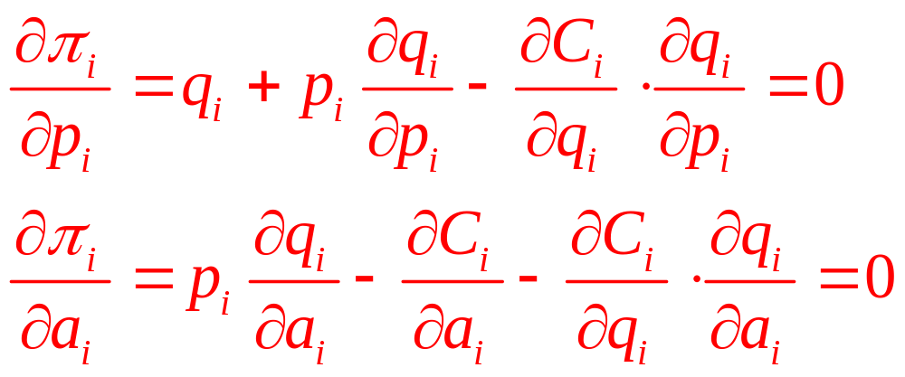
Bertrand competition with differentiated products
Firm i’s
  Total cost: C_{i}(q_{i}, a_{i})
  Profit: π_{i} = p_{i}q_{i} – C_{i}(q_{i}, a_{i})
First-order conditions for a maximum:

Slide 30
Bertrand competition with differentiated products
Profit-maximizing level of output
  Marginal revenue is equal to marginal cost
Additional differentiation activities
  Should be pursued up to the point at which the additional revenues they generate are equal to their marginal costs

Slide 31
15.4 Toothpaste as a Differentiated Product
Two firms produce toothpaste
  One a green gel and the other a white paste
  Suppose that production is costless
Demand for product i, q_{i} = a_{i} – p_{i} + p_{j}/2
  The goods are gross substitutes
Firm i’s profit: π_{i} = p_{i}q_{i} – C_{i}(q_{i}) = p_{i}(a_{i} – p_{i} + p_{j}/2)
  Where C_{i}(q_{i}) = 0
  First-order condition for profit maximization
∂π_{i} /∂p_{i} = a_{i} – 2p_{i} + p_{j} /2 =0

Slide 32
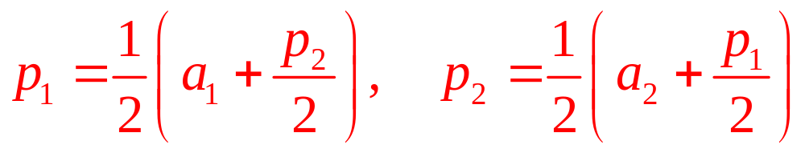
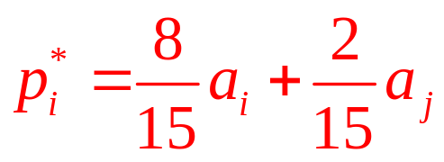
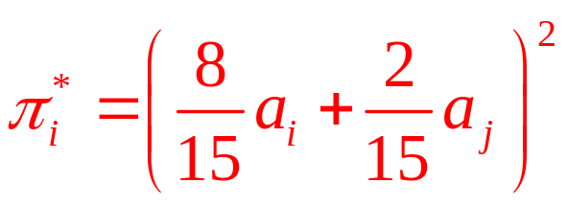
15.4 Toothpaste as a Differentiated Product
Best-response functions
Nash equilibrium prices
Profits

Slide 33
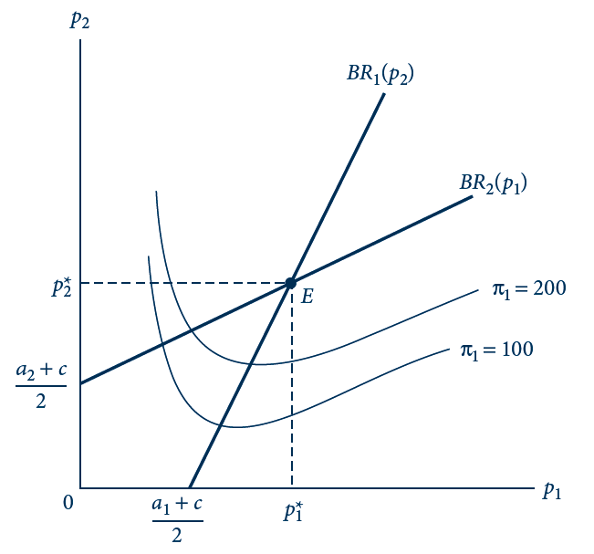
15.4 Best Responses for Bertrand Model with
Differentiated Products
Firm’ best responses are drawn as thick lines; their intersection (E) is the Nash equilibrium. Isoprofit curves for firm 1 increase moving out along firm 1’s best-response function.

Slide 34
15.5 Hotelling’s Beach
Ice cream stands located on a beach
  Demanders are located uniformly along the beach
    One at each unit of beach
  Ice cream cones are costless to produce
  But carrying them back to one’s place on the beach results in a cost of td ²
    t = temperature
    d = distance

Slide 35
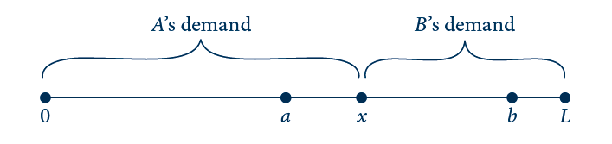
15.5 Hotelling’s Beach
Ice cream stands A and B are located at points a and b along a beach of length L. The consumer who is indifferent between buying from the two stands is located at x. Consumers to the left of x buy from A and to the right buy from B.

Slide 36
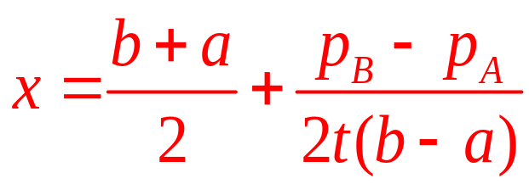
15.5 Hotelling’s Beach
A person located at point x will be indifferent between stands A and B if
p_{A} + t(x – a)² = p_{B} + t(b – x)²
  Where p_{A} and p_{B} are the prices charged by each stand
Solving for x we get
  If the two stands charge an equal price, the indifferent consumer is located midway between a and b

Slide 37
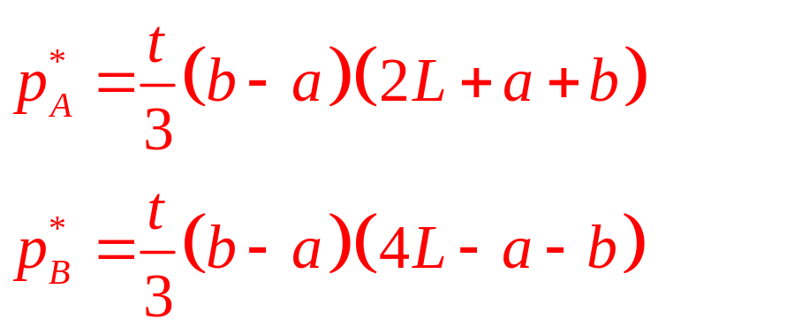
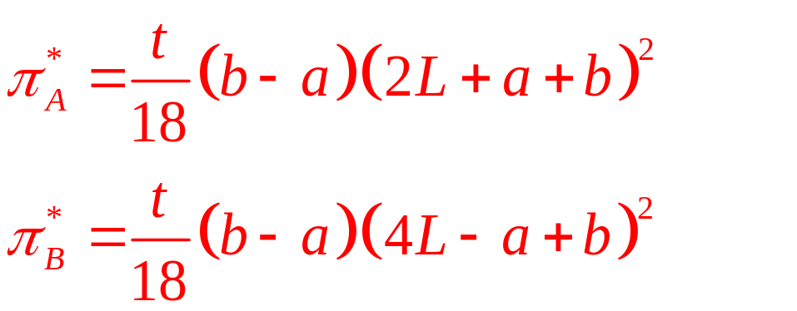
15.5 Hotelling’s Beach
The Nash equilibrium prices:
Profits for the two firms:

Slide 38
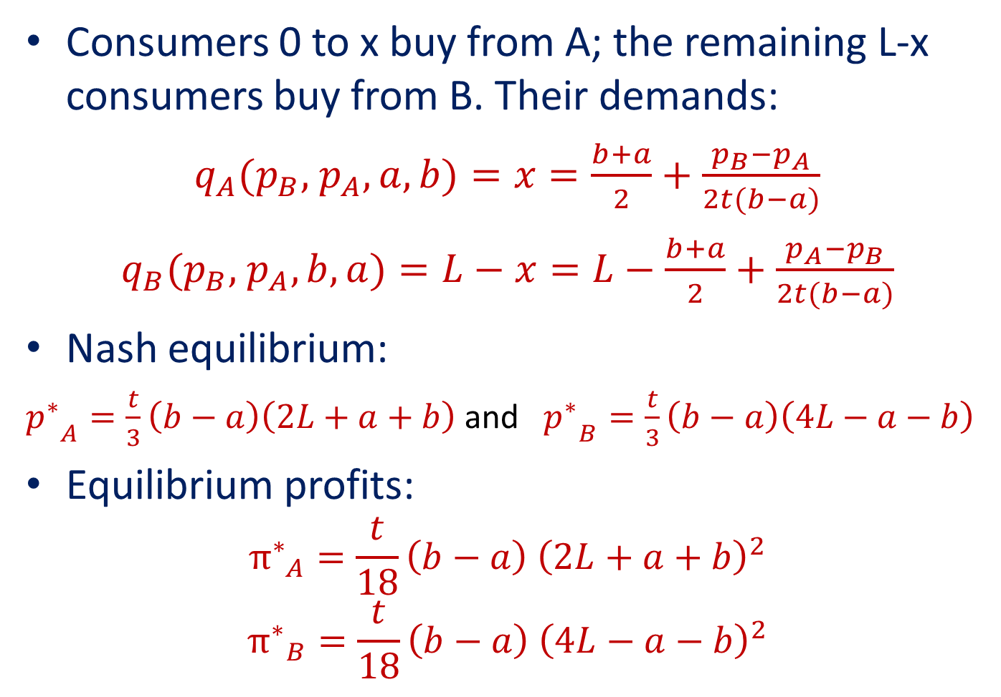
15.5 Hotelling’s Beach
Consumers 0 to x buy from A; the remaining L-x consumers buy from B. Their demands:
$q_{A}(p_{B},$ $p_{A}, a, b)=x=\frac{b+a}{2}+\frac{p_{B}−p_{A}}{2t(b−a)}$
$q_{B}(p_{B},$ $p_{A}, b, a)=L−x=L−\frac{b+a}{2}+\frac{p_{A}−p_{B}}{2t(b−a)}$
Nash equilibrium:
${p^{∗}}_{A}^{}=\frac{t}{3}\left(b−a\right)\left(2L+a+b\right)$ and ${p^{∗}}_{B}^{}=\frac{t}{3}\left(b−a\right)\left(4L−a−b\right)$
Equilibrium profits:
$${π^{∗}}_{A}^{}=\frac{t}{18}\left(b−a\right){ \left(2L+a+b\right)}^{2}$$
$${π^{∗}}_{B}^{}=\frac{t}{18}\left(b−a\right){ \left(4L−a−b\right)}^{2}$$

Slide 39
Consumer Search and Price Dispersion
Hotelling’s model
  It is possible that competitors may have some ability to charge prices above marginal cost and earn positive profits
    Even if the physical characteristics of the goods they sell are identical
Assume demanders face a search cost
  Stores avoid the Bertrand paradox
  All stores charge monopoly price

Slide 40
Tacit Collusion
Tacit collusion
  Is not the same as an explicit cartel
  Can only be enforced through punishments internal to the market
Repeating the stage game T times does not change the outcome
  The only subgame perfect equilibrium is to repeat the stage-game Nash equilibrium in each of the T periods: Marginal cost pricing

Slide 41
Tacit Collusion
If the stage game is repeated infinitely, the folk theorem applies
  Any feasible and individually rational payoff
  Can be sustained each period as long as the discount factor (δ) is close enough to 1

Slide 42
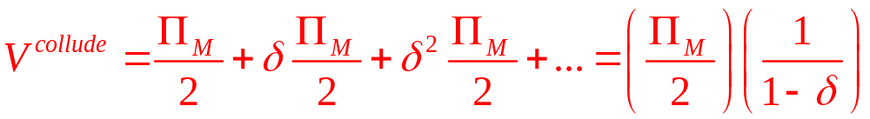
Tacit Collusion
Two firms in a duopoly
  Agree to tacitly collude to sustain the monopoly price by using a grim trigger strategy
  Successful tacit collusion provides the profit stream

Slide 43
Tacit Collusion
If a firm deviates
  It will earn all of the monopoly profit for itself in the current period
  The deviation will trigger the grim strategy of marginal cost pricing for all future periods
  The stream of profits from deviating is
  V^{deviate} = Π_{M}

Slide 44
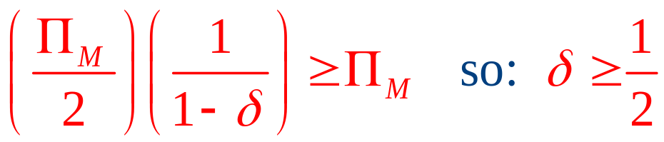
Tacit Collusion
For deviation not to be profitable
  It must be that V^{collude} ≥ V^{deviate}
To prevent deviation
  Firms must value the future enough that:
    The threat of losing profits by reverting to the one-period Nash equilibrium
    Outweighs the benefit of undercutting and taking the whole monopoly profit in the present period

Slide 45
15.6 Tacit Collusion in a Bertrand Model
Only 2 firms produce a medical device
  That is produced at constant average and marginal cost of $10
Demand for the device, Q = 5,000 – 100P
If the Bertrand game is played in a single period
  Each firm will charge $10
  A total of 4,000 devices will be sold
  At the monopoly price, each firm would earn a profit of $20,000

Slide 46
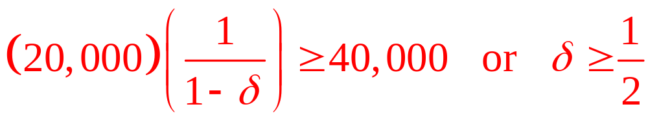
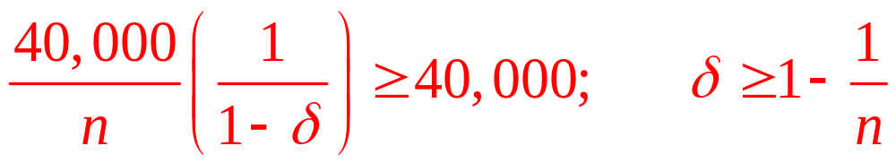
15.6 Tacit Collusion in a Bertrand Model
Collusion at the monopoly price is sustainable if
Now, suppose there are n firms, Bertrand oligopoly
  Monopoly profit is $40,000, but each firm’s share is 40,000/n
  n firms can successfully collude on the monopoly price if

Slide 47
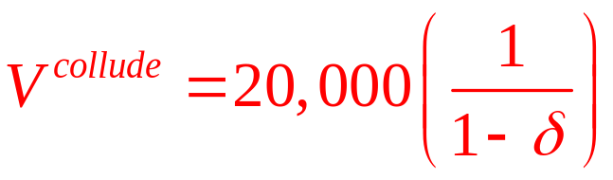
15.7 Tacit Collusion in a Cournot Model
Two firms producing medical devices
  Each period they now engage in quantity (Cournot) competition
  Monopoly outcome in a period
    Firms need to produce 1,000 each
    Price = $30
    Total profits = $40,000
    Firm profits = $20,000
    Present discounted value of the stream of these collusive profits:

Slide 48
15.7 Tacit Collusion in a Cournot Model
If the inverse demand is P = 50 – Q/100
  Firm 1’s profit: π₁ = Pq₁ – cq₁ = q₁[40-(q₁+q₂)/100]
  Best-response function: q₁=2,000-q₂/2
Firm 1’s optimal deviation
  When firm 2 produces 1,000 units
  Is to increase its output from 1,000 to 1,500
  Firm 1 earns $22,500 in the period in which it deviates

Slide 49
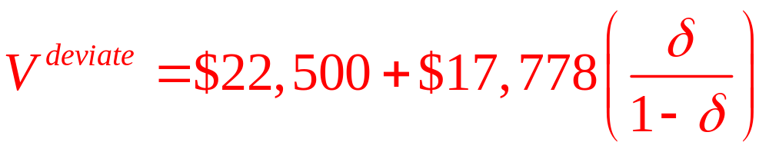
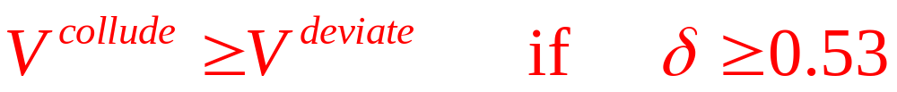
15.7 Tacit Collusion in a Cournot Model
Trigger strategies: reverting to the Nash equilibrium of the stage game
  Nash equilibrium outputs: q₁*=q₂*=4,000/3
  Profits: π₁*=π₂*= $17,778
  Firm 1’s present discounted value of the stream of profits from deviation
  We have

Slide 50
Longer-Run Decisions:
Investment, Entry, and Exit
When making long-run decisions
  An oligopolist must consider how rivals will respond
  How easy it is to reverse a decision once it has been made
  Value flexibility and reversibility
  Value commitment
    Firm can gain first-mover advantage

Slide 51
Flexibility Versus Commitment
How easy it is to reverse a decision once it has been made?
  Absent strategic considerations (monopolist) a firm would always value flexibility and reversibility
  The strategic considerations that arise in an oligopoly setting may lead a firm to prefer its decision be irreversible

Slide 52
Sunk Costs
Sunk costs
  Expenditure on an investment that cannot be reversed and has no resale value
  Allow the firm to produce in the market but have no residual value if the firm leaves the market
  Could include expenditures on unique types of equipment or job-specific training of workers

Slide 53
First-Mover Advantage in the Stackelberg Model
Similar to the duopoly version of the Cournot model
  Except firms move sequentially
  Firm 1 (the leader) chooses q₁ first
  Firm 2 (the follower) chooses q₂ after seeing q₁

Slide 54
First-Mover Advantage in the Stackelberg Model
Solve the model by backward induction
  Begin with output of the follower (q₂)
    This results in a best-response function for firm 2 [BR₂(q₁)]
  Substitute BR₂(q₁) into Firm 1’s profit function
  π₁ = P(q₁ + BR₂(q₁))q₁ – C₁(q₁)

Slide 55
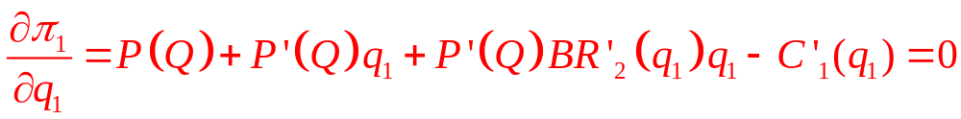
First-Mover Advantage in the Stackelberg Model
First-order condition:
S
  This is the same FOC as in the Cournot model except for the addition of the strategic effect of Firm 1’s output on Firm 2 (S)

Slide 56
First-Mover Advantage in the Stackelberg Model
The strategic effect
  Will lead Firm 1 to produce more than it would have in a Cournot model
  This leads Firm 2 to lower output
  If Firm 2 lowers output, the market price will rise, increasing Firm 1’s revenue from existing sales

Slide 57
First-Mover Advantage in the Stackelberg Model
The strategic effect would not occur if
  The leader’s output was unobservable to the follower
  The leader could reverse its output choice in secret
The leader
  Must be able to commit or else firms are back in the Cournot game

Slide 58
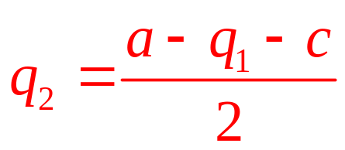
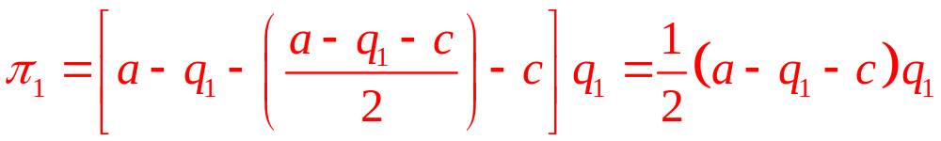
15.8 Stackelberg Springs
Natural springs duopoly
  Choose output levels sequentially
  Firm 1 is assumed to be the leader
  Firm 2 is assumed to be the follower
  Firm 2’s best-response function:
  Firm 1’s profit function:

Slide 59
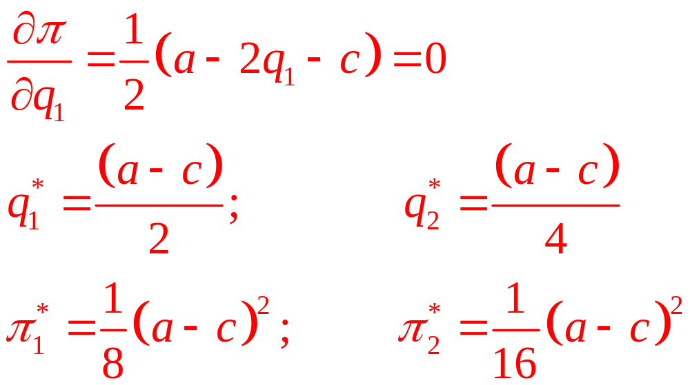
15.8 Stackelberg Springs
Natural springs duopoly
  First-order condition:

Slide 60
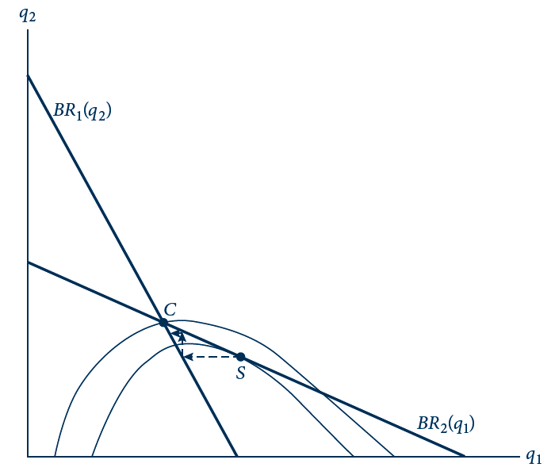
15.6 Stackelberg Game
Best-response functions from the Cournot game are drawn as thick lines. Frown-shaped curves are firm 1’s isoprofits. Point C is the Nash equilibrium of the Cournot game (invoking simultaneous output choices). The Stackelberg equilibrium is point S, the point at which the highest isoprofit for firm 1 is reached on firm 2’s best-response function. At S, firm 1’s isoprofit is tangent to firm 2’s best-response function. If firm 1 cannot commit to its output, then the outcome function unravels, following the dotted line from S back to C.

Slide 61
Contrast with Price Leadership
In the Stackelberg game, the leader uses a “top dog” strategy
  Aggressively overproduces to force the follower to scale back production
  The leader earns more (than it would in the Cournot game), while the follower earns less

Slide 62
Contrast with Price Leadership
The leader could follow a “puppy dog” strategy
  Increases its price, producing less output than in a simultaneous-move game
  Acts less aggressively, leading its rival to compete less aggressively

Slide 63
Contrast with Price Leadership
Difference between these two games:
  The slopes of the best-response functions differ
    “top dog” strategy leads to a downward-sloping best-response function for Firm 2
    “puppy dog” strategy leads to an upward-sloping best-response function for Firm 2

Slide 64
15.9 Price-Leadership Game
Two firms
  Chose price for differentiated toothpaste brands
    Firm 1 chooses price before firm 2
  Assume a₁ = a₂ = 1 and c = 0
  Firm 2’s best response to its rival’s choice p₁:
  p₂ = ½ + p₁/4
  Firm 1’s profit: π₁=(p₁/8)(10-7p₁)
  p₁* = 0.714, p₂* = 0.679, π₁* = 0.44, π₂* = 0.46
  Both firms’ prices and profits are higher than in the simultaneous game
    The follower earns even more than the leader

Slide 65
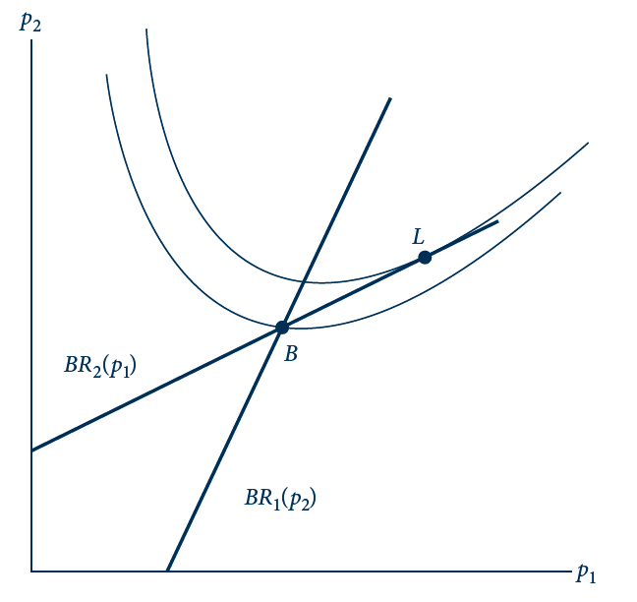
15.7 Price-Leadership Game
Thick lines are best-response functions from the game in which firms choose prices for differentiated products. U-shaped curves are firm 1’s isoprofits. Point B is the Nash equilibrium of the simultaneous game, and L is the subgame-perfect equilibrium of the sequential game in which firm 1 moves first. At L, firm 1’s isoprofit is tangent to firm 2’s best response.

Slide 66
Strategic Entry Deterrence
First-mover advantages
  May be large enough to deter all entry by rivals
  It may not be in the firm’s best interest to create that large a capacity

Slide 67
15.10 Deterring Entry of a Natural Spring
Add an entry stage to the Stackelberg Natural Springs example
  Firm 2 must decide whether to enter the market after seeing Firm 1’s output level
  Entry for Firm 2 requires a sunk cost, K₂
    Firm 1 incurred sunk cost before the start of the game
  Assume a = 120 and c = 0
Calculate Firm 1’s profit if it accommodates entry
  q₁^{acc} = (a – c)/2 = 60; π₁^{acc} = (a – c)²/8 = 1,800

Slide 68
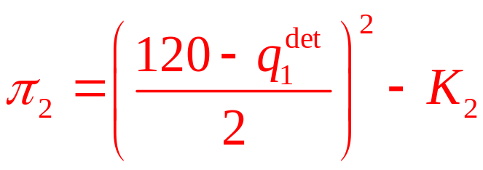
15.10 Deterring Entry of a Natural Spring
Compute Firm 1’s profit if it deters entry
  Firm 1 needs to produce and amount high enough that Firm 2 cannot earn enough profit to cover sunk cost
Firm 2’s best-response function:
q₂ = (120 – q₁)/2
Firm 2’s profit function:

Slide 69
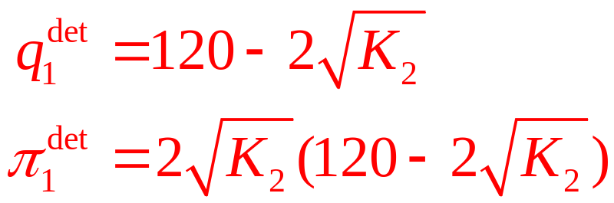
15.10 Deterring Entry of a Natural Spring
Setting Firm 2’s profit to zero yields:
Compare π₁^{acc} with π₁^{det}
  The level of K₂ at which the firm would be indifferent is K₂ = 77
  If K₂ < 77, entry is cheap and Firm 1 would have to increase its output to 102 to deter entry

Slide 70
Signaling
The ability to signal is another first-mover advantage
  If a second mover has incomplete information about the market
    It may try to watch the first-mover to learn about market conditions
  The first mover may distort its actions to manipulate what the second mover learns

Slide 71
Entry-Deterrence Model
A game where two firms choose a price for their differentiated products
  Firm 1 is a first mover
  Firm 2 is a second mover
Firm 1 has private information about its marginal costs
  High costs with a probability of Pr(H)
  Low costs with a probability of
  Pr(L) = 1 – Pr(H)

Slide 72
Entry-Deterrence Model
In period 1, Firm 1 serves the market alone
  At the end of the period, Firm 2 observes p₁ and considers entry
If Firm 2 enters
  It faces a sunk cost of K₂
  Learns the true nature of Firm 1’s costs

Slide 73
Entry-Deterrence Model
The firms then behave as duopolists in the second period
  Choosing prices for differentiated products
If Firm 2 does not enter
  It obtains a payoff of zero
  Firm 1 serves the market alone
Assume there is no discounting between periods

Slide 74
Entry-Deterrence Model
D_{i}^{t}
  Duopoly profit for firm i if Firm 1 is of type t (low-cost, high-cost)
Assume that D₂^{L} < K₂ < D₂^{H}
  Firm 2 earns more than its entry cost only if Firm 1 is high-cost
If Firm 1 is low cost, it has only one relevant action
  Setting the monopoly price (p₁^{L})

Slide 75
Entry-Deterrence Model
If Firm 1 is high cost
  Set the monopoly price associated with its type (p₁^{H})
  Or: choose the same price as the low-cost type (p₁^{L})
M₁^{t} - Firm 1’s monopoly profit if it is of type t
R
  Loss in Firm 1’s profit if it is high-cost, but chooses p₁^{L}

Slide 76
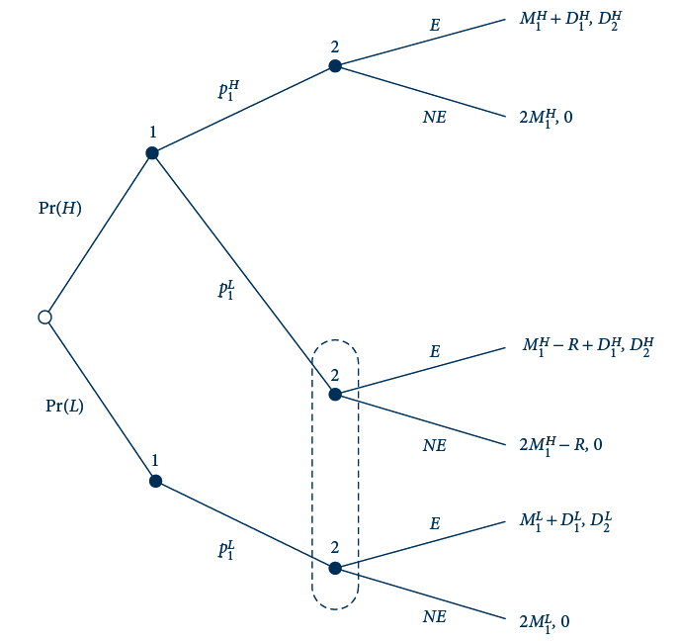
15.8 Signaling for Entry Deterrence
Firm 1 signals its private information about its cost (high H or low L) through the price it sets in the first period. Firm 2 observes firm 1’s price and then decides whether to enter. If firm 2 enters, the firms compete as duopolists; otherwise, firm 1 operates alone on the market again in the second period. Firm 2 earns positive profit if and only if it enters against a high cost rival.

Slide 77
Separating Equilibrium
In a separating equilibrium
  The different types of the first-mover must choose different actions
There is only one possibility for Firm 1
  The low-cost type chooses p₁^{L}
  The high-cost type chooses p₁^{H}

Slide 78
Separating Equilibrium
Firm 2 sees Firm 1’s actions
  Stays out is firm 1 charges p₁^{L}
  Enters if Firm 1 charges p₁^{H}
Would a high-cost Firm 1 prefer to charge a price of p₁^{L}?
  Only if: R < M₁^{H} – D₁^{H}

Slide 79
Pooling Equilibrium
If R < M₁^{H} – D₁^{H}
  The high type would like to pool with the low type if pooling deters entry
  Pooling deters entry if Firm 2’s prior belief that Firm 1 is the high type is low enough that Firm 2’s expected payoff from entering is less than zero

Slide 80
Predatory Pricing
Predatory pricing
  Charging an artificially low price
    To prevent potential rivals from entering
    To force existing rivals to exit
  May be explained by the incomplete-information model of entry deterrence

Slide 81
How Many Firms Enter?
In order for a market to be oligopolistic, there must be barriers to entry
  Sunk cost to enter
  Government intervention (patents, licensing)
  Search costs faced by consumers
  Product differentiation (brand loyalty)
  Entry deterrence by existing firms

Slide 82
How Many Firms Enter?
Long-run equilibrium
  Large number of symmetric firms that are potential entrants into a market
    Make the decision simultaneously
  Entry requires a sunk cost, K
  n = number of firms that decide to enter
  g(n) = profit earned by a firm (not including sunk cost)
    Expect g’(n) < 0

Slide 83
How Many Firms Enter?
Long-run equilibrium
  The sub-game perfect equilibrium number of firms (n*) will satisfy two conditions
    They earn enough to cover their entry costs
      g(n*) ≥ K
    An additional firm cannot cover its entry cost
      g(n*+1) ≤ K

Slide 84
How Many Firms Enter?
Is the long-run equilibrium efficient?
  A benevolent social planner would choose n to maximize: CS(n) + ng(n) – nK
    CS(n) is equilibrium consumer surplus
    ng(n) is equilibrium gross profits
    nK is total expenditure on sunk entry costs

Slide 85
How Many Firms Enter?
Long-run equilibrium number of firms (n*)
  May be greater or less than the social optimum (n**) depending on two effects
    The appropriability effect
    The business-stealing effect

Slide 86
How Many Firms Enter?
The appropriability effect
  The social planner takes account of increased consumer surplus from lower prices
  Firms do not
  This implies that n** > n*

Slide 87
How Many Firms Enter?
The business-stealing effect
  Entry causes the profits of existing firms to fall
  The marginal firm does not consider the drop in other firms’ profits when making its entry decision (the social planner would)
  This implies that n* > n**

Slide 88
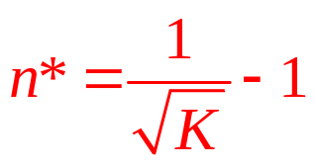
15.11 Cournot in the Long Run
Determine the long-run equilibrium number of firms in the market
  K - sunk cost a firm must pay to enter the market in an initial entry stage
  One period of Cournot competition after entry
  Assume that a = 1 and c = 0
  Individual firm’s gross profit: g(n) = [1/(n+1)]²
Long-run equilibrium number of firms
  Is the greatest integer n* satisfying g (n) ≥ K

Slide 89
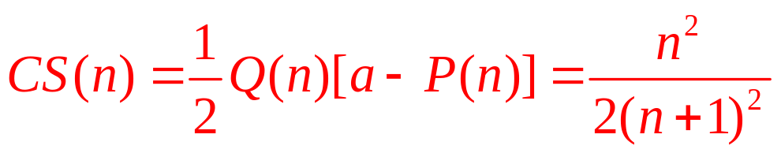
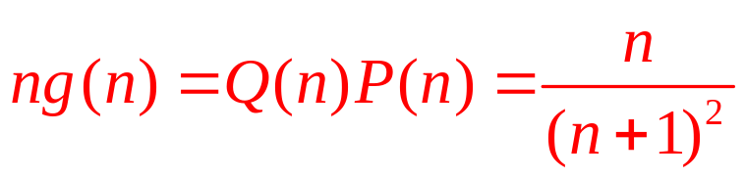
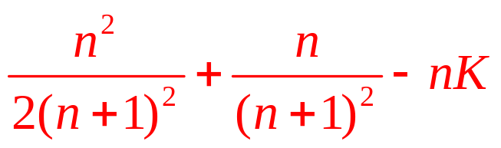
15.11 Cournot in the Long Run
Social planner’s problem
  Consumer surplus
  Total profits for all firms
  Social planner’s objective function

Slide 90
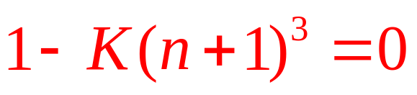
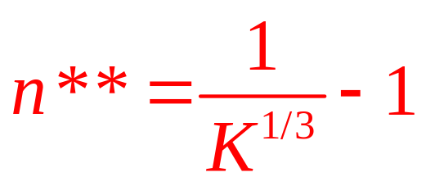
15.11 Cournot in the Long Run
Social planner’s problem
  First-order condition with respect to n
  Optimal number of firms for a social planner

Slide 91
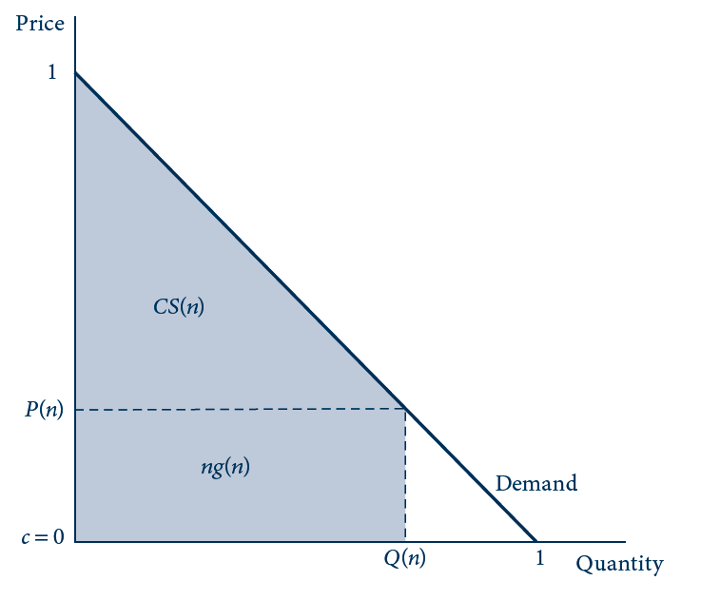
15.9 Profit and Consumer Surplus in
Example 15.11
Equilibrium for n firms drawn for the demand and cost assumptions in Example 15.11. Consumer surplus, CS(n), is the area of the shaded triangle. Total profits ng(n) for all firms (gross of sunk costs) is the area of the shaded rectangle.

Slide 92
Feedback Effect
Feedback effect
  The more profitable a market is for a given number of firms
  The more firms will enter the market
  Making the market more competitive and less profitable than it would be if the number of firms was fixed

Slide 93
Monopoly on Innovation
Product innovations
  The invention of a product that did not exist before
Process innovations
  Reduce the cost of producing existing products

Slide 94
Monopoly on Innovation
The dissipation effect
  Competition dissipates some of the profit from innovation
    And thus reduces the incentives to innovate
The replacement effect
  Firms gain less in incremental profit
    And thus have less incentive to innovate if the new product replaces an existing product

Slide 95
Competition for Innovation
New firms
  Are not always more innovative than existing ones
  The dissipation effect may counteract the replacement effect
Dominant firms
  Apply for “sleeping patents” to prevent entry
    Patents that are never implemented

Slide 96
Strategic substitutes and complements
Firms’ actions are strategic substitutes
  If an increase in the level of the action by one firm
  Is met by a decrease in that action by its rival
Actions are strategic complements
  If an increase in an action by one firm
  Is met by an increase in that action by its rival

Slide 97
Nash Equilibrium
Firm 1
  Profit, π₁(a₁,a₂)
  Best-response function BR₁(a₂)
Firm 2
  Profit, π₂(a₁,a₂)
  Best-response function BR₂(a₁)
Nash equilibrium, (a₁*,a₂*)
  Such that a₁* = BR₁(a₂*) and a₂* = BR₂(a₁*)

Slide 98
Best-response functions in more detail
  First-order condition for firm 1’s action choice: π₁¹(a₁,a₂)=0
  Assume that the profit function is concave: π₁₁¹(a₁,a₂)<0
  Unique maximum: a₁ = BR₁(a₂)
a₁ and a₂ are strategic substitutes
  If best responses are downward sloping
a₁ and a₂ are strategic complements
  If best responses are upward sloping

Slide 99
Inferences from the profit function
Determine whether actions are strategic substitutes or complements
  By drawing inferences directly from the profit function
  First-order condition: π₁¹(a₁,a₂)=0, or π₁¹(BR₁(a₂),a₂)=0
  Differentiate with respect to a₂: π₁₁¹ BR’₁+ π₁₂¹=0, or BR’₁= - π₁₂¹/ π₁₁¹
  BR’₁ has the same sign as π₁₂¹

Slide 100
Cournot model
Profits: π¹(q₁,q₂)=q₁P(q₁,q₂)-C(q₁)
  First-order condition:
  π₁¹ = q₁ P’(q₁ + q₂) + P(q₁+q₂) – C’(q₁)
  The derivative with respect to q₂:
  π₁₂¹ = q₁ P’’ + P’
  The sign of π₁₂¹ will depend on the sign of P’’
    P’<0
    If P’’=0 (linear demand), then π₁₂¹ is negative

Slide 101
Bertrand model w/ differentiated products
Demand: q₁ = D¹(p₁,p₂)
Profit:
  π¹ = p₁q₁ - C(q₁) = p₁ D¹(p₁,p₂) - C(D¹(p₁,p₂))
First-order condition with respect to p₁
  π₁¹ = p₁ D₁¹(p₁,p₂) + D¹(p₁,p₂) - C(D¹(p₁,p₂)) D₁¹(p₁,p₂)
Cross-partial derivative
  π₁₂¹ = p₁ D₁₂¹ + D₂¹ – C’D₁₂¹ – C’’D₂¹D₁¹

Slide 102
Entry accommodation: sequential game
Sequential game
  Firm 1 chooses a₁ and then firm 2 chooses a₂
  Firm 1 finds it more profitable to accommodate than to deter firm 2’s entry
  Firm 1’s profit function: π¹(a₁,BR₂(a₁))
  First-order condition: π₁¹ + π₂¹BR’₂ = 0
    Where S = π₂¹BR’₂ - captures the strategic effect of moving first

Slide 103
Entry accommodation: sequential game
Sequential game
  The sign of S is determined by the signs of the two factors in S
    These two factors will typically have the same sign
    Implying that S > 0
    The first mover will typically distort its action upward in the sequential game compared with the simultaneous game

Slide 104
Extension to general investments
K₁
  General investment sunk at the outset of the game
The two firms
  Choose their product-market actions a1 and a₂ simultaneously in the second period
Firms’ profits: π¹(a₁,a₂,K₁) and π²(a₁,a₂)

Slide 105
Extension to general investments
Firms’ actions in a subgame-perfect equilibrium:
a₁*(K₁)=BR₁(a₂*(K₁),K₁) and a₂*(K₁)=BR₂(a₁*(K₁))
Nash equilibrium profits in the subgame following firm 1’s choice of K₁ are
π¹*(K₁)= π¹(a₁*(K₁),a₂*(K₁),K₁) and
π²*(K₁)= π²(a₁*(K₁),a₂*(K₁))

Slide 106
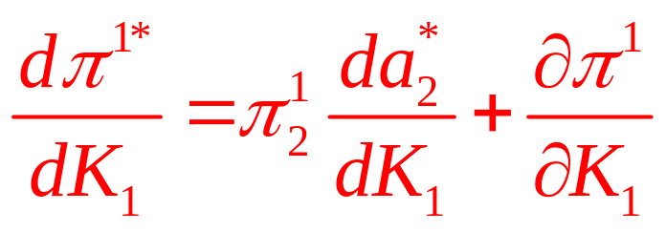
Extension to general investments
Totally differentiating π¹*(K₁), the first-order condition
s
  S is the strategic effect of an increase in K₁ on firm 1’s profit through firm 2’s action

Slide 107
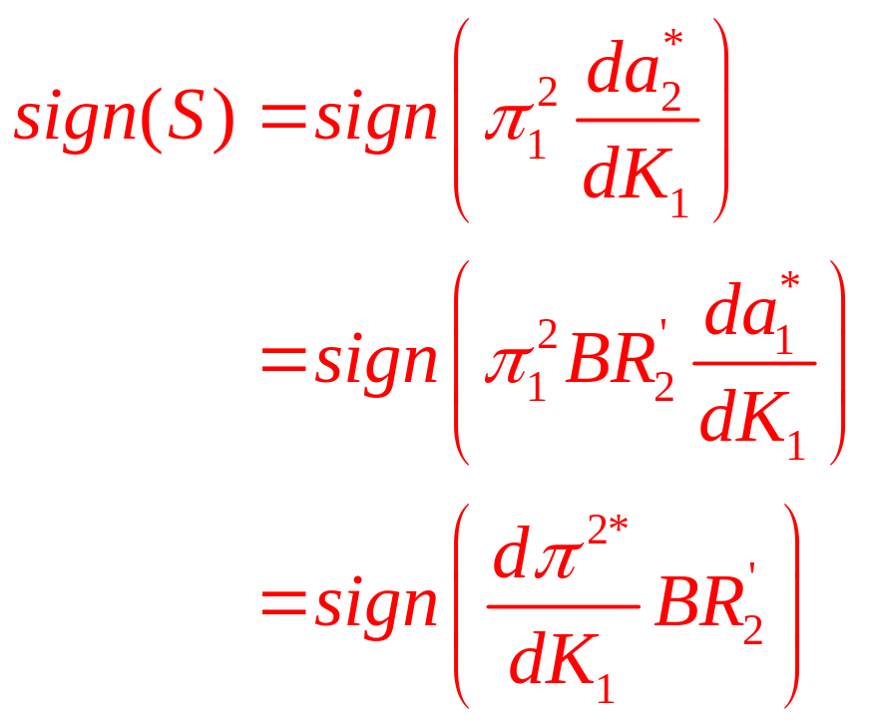
Extension to general investments
The sign of S
  Determines whether firm 1 strategically over- or under-invests in K₁ when it can make a strategic commitment

Slide 108
Most-favored customer program
Most-favored customer program
  K₁ is a 0-1 choice
  Rebates the price difference to past customers
    If the firm lowers its price in the future
  Makes firm 1 ‘‘soft’’ by reducing its incentive to cut price
  Leads to less aggressive price competition
    Higher prices and profits

Slide 109
Extension to general investments
Trade policy
  K₁ is not a choice by firm 1 itself
    It is a government’s policy choice on behalf of its domestic firms
    Export subsidy program
    Makes firm 1 “tough”
Entry deterrence
    Firm 1 prefers to deter rather than accommodate entry
    Firm 1’s objective is to choose K₁ to reduce firm 2’s profit π²* to zero

Slide 110
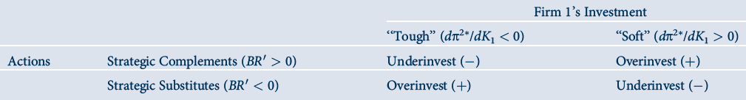
15.1 Strategic Effect when Accommodating Entry

